Slide 1
DistDGL: Distributed Graph Neural Network Training for Billion-Scale Graphs
2023-03-29
박현우

Slide 2
Table of Contents
Problem specification
Contribution
Distributed Training Architecture
Evaluation

Slide 3
Problem specification
Hardships in distributed training GNN on giant Graph at scale:
Generate proper Mini-batch on large graph
Distributed parameters update on GNN
Overhead due to Network Communication in cluster.

Slide 4
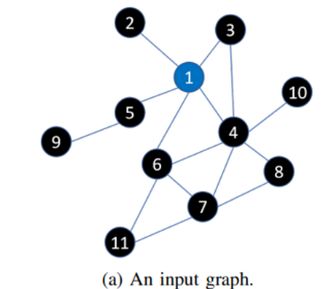
1.1 Mini-batch Training on GNN
Mini-batch training on GNNs is difficult because:
Graph inherently represents the dependencies among training samples
each mini-batch must incorporate those depending samples whose number usually grows exponentially with Search depths (hops).
Example: Mini-batch for Node 1 as Target
For search depth = 1 : [2, 3, 4, 5, 6]
For search depth = 2 : [], [4], [3, 6, 7, 8, 10], [9], [4, 7, 11]
…

Slide 5
1.2 Distributed Parameters update on GNN
Previous distributed GNNs are designed for Full graph computation expressed in the vertex-centric program paradigm, not edges. i.e. Entire clusters are synced to compute the full graph as a whole.
Existing domain-specific frameworks (DGL, PyTorch-Geometric) are mainly developed for single machine training.
Techniques in other domains can’t be well adopted to GNN due to vertex dependencies.
Others suffer from the huge network traffic caused by fetching neighbor node data.

Slide 6
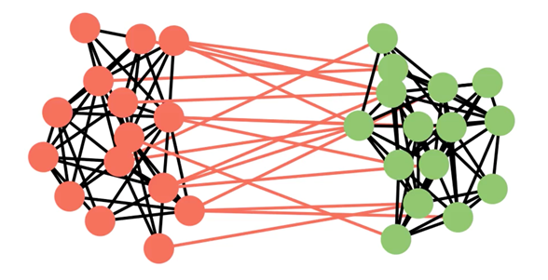
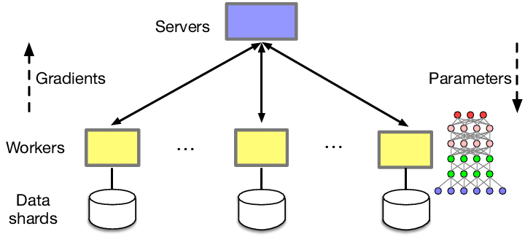
1.3 Network Traffic Overload
Due to the vertex dependency, distributed GNN training requires to fetch hundreds of neighbor vertex data.
c.f. Exchanging the gradients on other domains.
Size of Data to transfer : Vertex Data >>> Gradients
▲ 2 mini-batches with lots of neighboring vertices
▲ Distributed training on traditional DL.

Slide 7
2.1. Contribution - Solve Hardships
To generate proper, well-balanced mini-batch: DistDGL allows ego-networks forming the mini-batches to efficiently include non-local nodes (i.e. Nodes in other partitions/machines).
For distributed training on GNN: DistDGL follows Synchronous training approach
To reduce network overhead: DistDGL adopts METIS, a high-quality and lightweight min-cut graph partitioning algorithm.

Slide 8
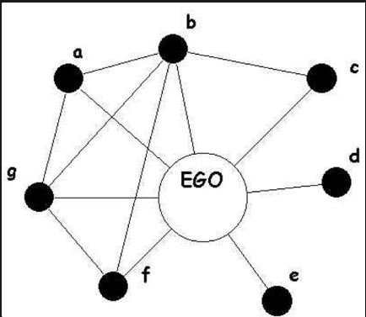
Terminology - Ego Network
Ego networks consist of
a focal node ("ego")
the nodes to whom ego is directly connected (these are called "alters")
In GNN context,
Ego node becomes target
Alters become features.

Slide 9
2.2. Contribution - Further achievements
Design Distributed training architecture for training GNN on giant graph.
Deploy multiple load balancing optimizations to further tackle partition imbalance issue.
Further reduce network communication in sampling.
Provide distributed embeddings with efficient sparse updates for transductive graph models.
Provide all these Distributed components with APIs compatible to DGL.

Slide 10
3. Distributed Training Architecture
DistDGL distributes the mini-batch training process of GNN models across a cluster of machines
Then, it trains the model by Synchronous stochastic gradient descent (SGD) training.
In procedure, each machine:
computes model gradients for its own mini-batch
synchronizes gradients with others
finally updates the local model replica.
Comparison against Async SGD
Pros:
No worry about Stale gradients.
Faster converge with larger step-size
Cons:
Bottleneck for each update
Poor robustness to machine failure.

Slide 11
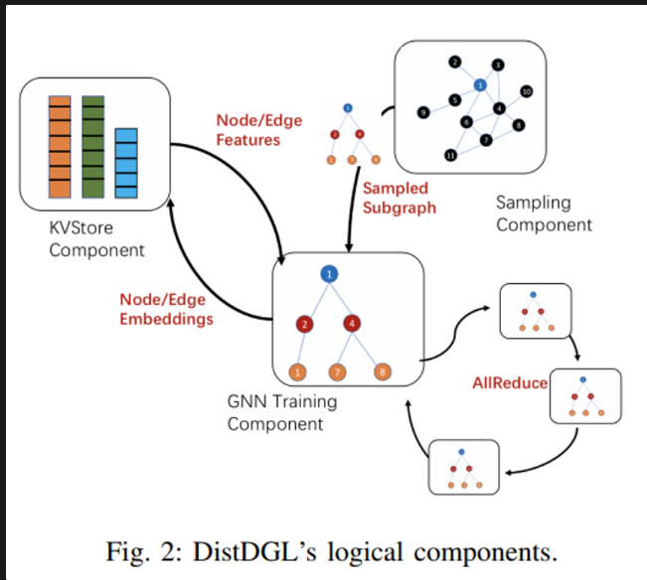
3. Distributed Training Architecture
DistDGL consists of the following logical components:
Samplers
A KVStore
Trainers
A dense model update component
Graph Partitioning as Preprocessing before distributed training.

Slide 12
3.1 Graph Partitioning
Goal of Graph Partitioning:
To split the input graph to multiple partitions with a minimal number of edges (min-cut graph partitioning)
To balance partitions across cluster.
This leads effects of :
Reducing communication overheads among cluster.
Statically balance the computations.
DistDGL’s Graph Partitioning involves 2 steps:
METIS algorithm
Balancing partitions

Slide 13
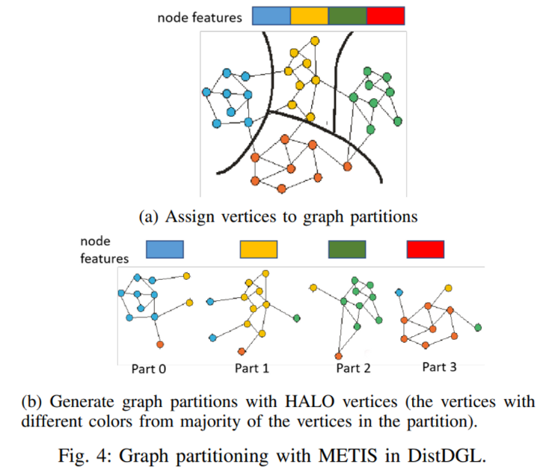
3.1.1 METIS
DistDGL adopts METIS as partitioning algorithm.
Procedure:
Assign densely connected vertices to the same partition to minimize the number of edge cuts between partitions.
Assign all incident edges to the same partition.
(2.) ensures that all the neighbors are accessible of the local vertices on the partition.
= Samplers can compute locally in most cases.

Slide 14
3.1.1 METIS
With METIS,
Each edge has a unique assignment
Some vertices may be duplicated.
For vertices in partition,
Core Vertices : Vertices uniquely assigned to a partition
HALO Vertices : Vertices duplicated by edge assignment strategy.

Slide 15
3.1.2 Balancing partitions
By default, METIS only roughly balances the number of vertices in a graph.
However, this is insufficient to generate balanced partitions for synchronous minibatch training.
e.g. Partitions with densely connected vertices would have much more batches than those with sparsely connected. (i.e. Num of batches increase faster as Search depth increases)
Sync minibatch training requires (Q)
The same number of batches from each partition per epoch
All batches to have roughly the same size

Slide 16
3.1.2 Balancing partitions
Allocate the same number of batches across all trainers per epoch
=> Can be formulated as Load Balancing Problem.
DistDGL leverages Multi-constraint mechanism in METIS to solve such load balancing problem.
Multi-constraint mechanism is also used to balance
Training/Validation/Test set vertices/edges
vertices/edges of different types (~ Stratified sampling for imbalance dataset)

Slide 17
3.1.2 Balancing partitions
METIS algorithm is based on Multi-level paradigm. i.e. Recursively partitioning by deepening search depths (hops).
To reduce complexity of both memory and computation, DistDGL extends METIS to only retain a subset of the edges.
In addition, to transform coarser graphs into finer graphs in sampling process, also extend to only retain the edges with the highest weights in the coarser graph.
i.e. preventing the graph being too deepened. (Too many edges)

Slide 18
3.1.2 Balancing partitions
After the graph partitioning, DistDGL manages two sets of IDs for vertex/edge.
Global vertex/edge ID to identify vertices/edges among cluster.
Local vertex/edge ID to efficiently locate vertices/edges in the partition.

Slide 19
3.1.2 Balancing partitions
At final step, to save memory for the mapping between global and local IDs, DistDGL relabels vertex and edge IDs
to ensure that all IDs of core vertices/edges in a partition fall into a contiguous ID range.
This relabeling allows:
mapping a global ID is binary lookup in a very small array
mapping a global ID to a local ID is a simple subtraction operation.

Slide 20
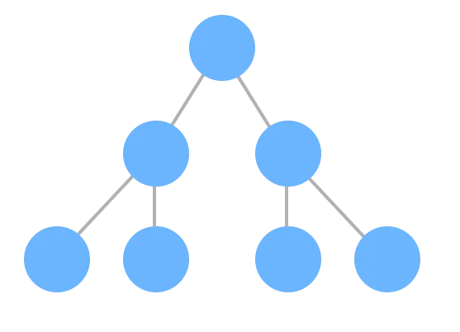
3.1.2 Balancing partitions
Leaf nodes have local ID range for each partition.
All leaf nodes are on successive array.
To obtain global ID from local ID, subtract length of global ID range of front partitions
Partition 1
Partition 2
Partition 3
Partition 4
Continuous Array

Slide 21
3.2 Distributed Key-Value Store
Despite the graph partitioning with densely connected vertices,
still need to read data from remote partitions. e.g. Sparse graphs with vertices in other partitions.
Accessing vertex/edge features usually accounts for the majority of communication in GNN distributed training.
To simplify the data access on other machines,
DistDGL developed a distributed in-memory key-value store (KVStore) dedicated to manage
Vertex/Edge features
Vertex Embeddings.

Slide 22
3.2 Distributed Key-Value Store
KVStore is specialized for
better co-location of node/edge features (in both KVStore and partitions)
faster network access
efficient updates on sparse embeddings
DistDGL flexibly aligns with graph partitions in each machine with separated partition policies for each machine.

Slide 23
3.2 Distributed Key-Value Store
Key optimization of KVStore is to use Shared Memory.
Thanks to co-location of data/computation within partitions, most of data access to KVStore is occurred on local machine.
Thus, instead of IPC, the KVStore server shares data with the trainer processes via shared memory,
without IPC-related overhead.
Also, for fast networks (e.g. Infiniband), DistDGL developed an optimized RPC framework.

Slide 24
3.3 Distributed Sampler
Sampling procedure:
The trainer issues sampling requests using the target vertices in the current partition.
The requests are dispatched to the machines according to the core vertex assignment (from Graph partitioning)
When received, sampler servers call DGL’s sampling operators on the local partition.
Transmit the result back to the trainer process.
The trainer aggregates all the results to generate a mini-batch.

Slide 25
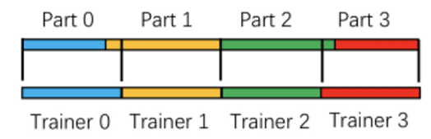
3.4 Mini-batch Trainer
To balance the computation in each trainer, DistDGL uses a two-level strategy to split the training set evenly
We MUST ensure that each trainer has the same number of training samples. (#)
To do so:
Evenly split the training samples based on their IDs
Assign the ID range to a machine whose graph partition has the largest overlap with the ID range.
This is viable thanks to ID relabeling.

Slide 26
3.4 Mini-batch Trainer
This misalignment is a tradeoff between
Load balancing
Data locality
In practice, as long as the graph partitioning balances the number of training samples between partitions, the tradeoff is negligible.

Slide 27
3.4 Mini-batch Trainer
For distributed CPU training, DistDGL parallelizes the computation with both
Multithreading for operator computations e.g. Matrix multiplication
Multiprocessing for cluster with NUMA architecture.
NOTE: More trainer processes result in more communication overhead for model parameter updates. (Tradeoff)

Slide 28
4. Evaluation
Basis for evaluation:
Can DistDGL train GNNs on large graphs on cluster in scale?
Can DistDGL effectively increase the data locality for GNN training?
Can load balancing strategies effectively balance the workloads in cluster?

Slide 29
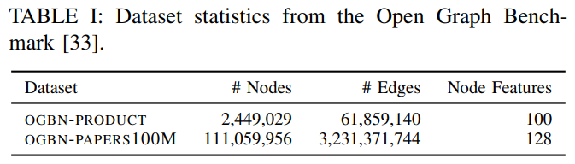
4.1. Benchmarks / Settings
Benchmarks
GraphSAGE model on two Open Graph Benchmark (OGB) datasets.
Settings
A cluster of eight AWS EC2 m5n.24xlarge instances (96 VCPU, 384GB RAM each) connected by a 100Gbps network.

Slide 30
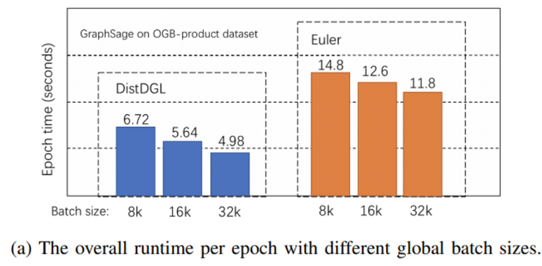
4.2. Comparison to other distributed GNN frameworks
Comparison of Training speed with Euler.
DistDGL gets 2.2× speedup over Euler in all different batch sizes

Slide 31
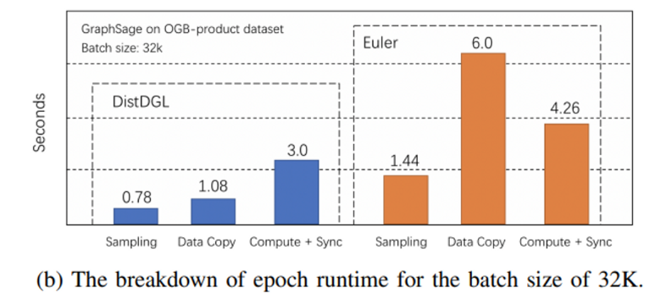
4.2. Comparison to other distributed GNN frameworks

Slide 32
4.2.1. Data Copy
The main advantage of DistDGL (5x speed up over Euler)
This is thanks to
METIS for Graph partitioning with minimal edge cuts.
Co-location of partition data within trainers for Network communication reduction.
Speed of data copy: (Nearly) Local memory copy of DistDGL <<< TCP/IP (RPC) of Euler.

Slide 33
4.2.2. Sampling / Implementation
Sampling (2x speed up over Euler)
Thanks to DistDGL samples majority of vertices and edges from the local partition
to generate mini-batches.
Implementation
DistDGL relies on DGL and PyTorch which are slightly faster than Tensorflow of Euler.
But, Batch computation and Gradient Synchronization are coupled in PyTorch.

Slide 34
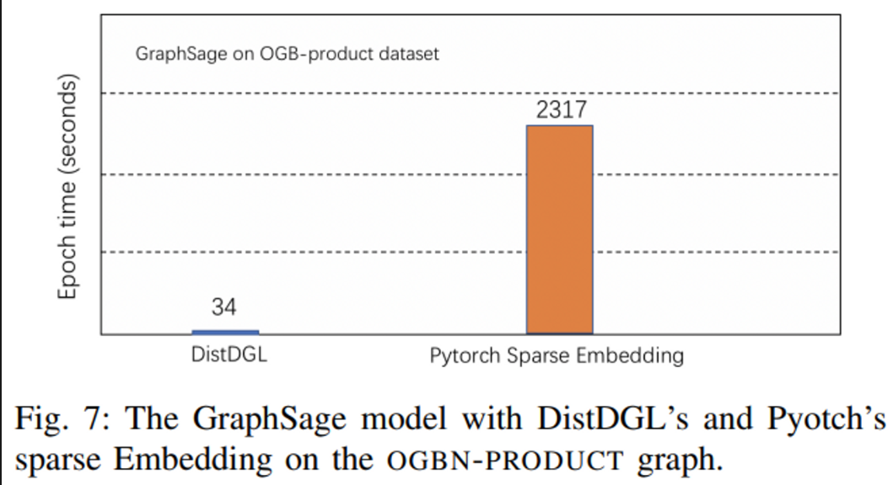
4.3. Comparison of Sparse Embedding performance
Sparse embedding performance is evaluated with modified GraphSage model.
Comparison target is PyTroch Sparse Embedding.

Slide 35
4.3. Comparison of Sparse Embedding performance
DistDGL gets almost 70x speed up.
This is thanks to efficient update of sparse embedding via KVStore.
In contrast, PyTorch (DistributedDataParallel Module) requires the gradient tensor must have the same shape,
deteriorating performance by padding the gradient tensor.

Slide 36
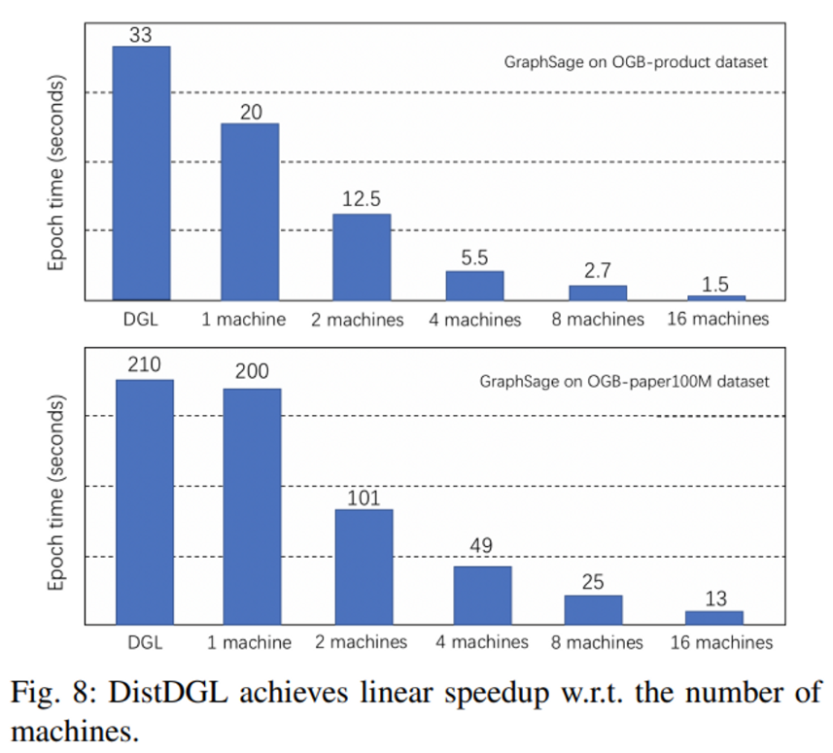
4.4. Scalability
DistDGL achieves a linear speedup as the number of machines increases.
This indicates that DistDGL’s optimization
well handles network communication.
well balances the workloads.

Slide 37
4.5. Ablation study for Graph partitioning
Comparison of DistDGL’s Graph partitioning (multi-constraints METIS) with two alternatives:
Random graph partitioning
Default METIS partitioning (without multi-constraints)

Slide 38
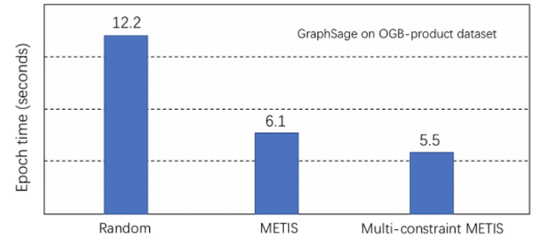
4.5. Ablation study for Graph partitioning
In OGB-product dataset,
Default METIS partitioning performs well compared with random partitioning, which suggests that METIS’ network communication reduction (due to partitioning) works well.
Multi-constraint METIS gains 4% improvement over Default METIS.

Slide 39
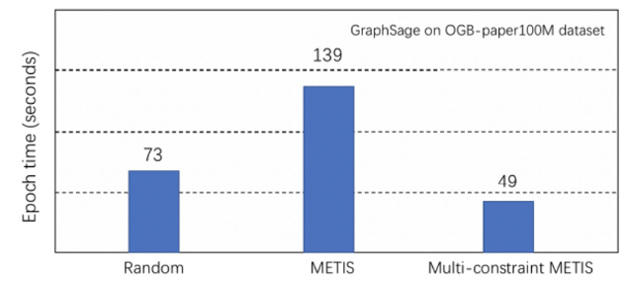
4.5. Ablation study for Graph partitioning
In OGB-paper dataset, where data is highly imbalanced,
Default METIS performs worse than Random partitioning.
This suggests that Multi-constraint METIS’ ability to further balancing partitions (Load Balancing) plays an important role in imbalanced dataset.

